Slide 1
Capstone Project Update
AuE-8360 Scaled Autonomous Vehicles
Chinmay Samak
PhD Candidate, CU-ICAR
csamak@clemson.edu
Tanmay Samak
PhD Candidate, CU-ICAR
tsamak@clemson.edu

Slide 2
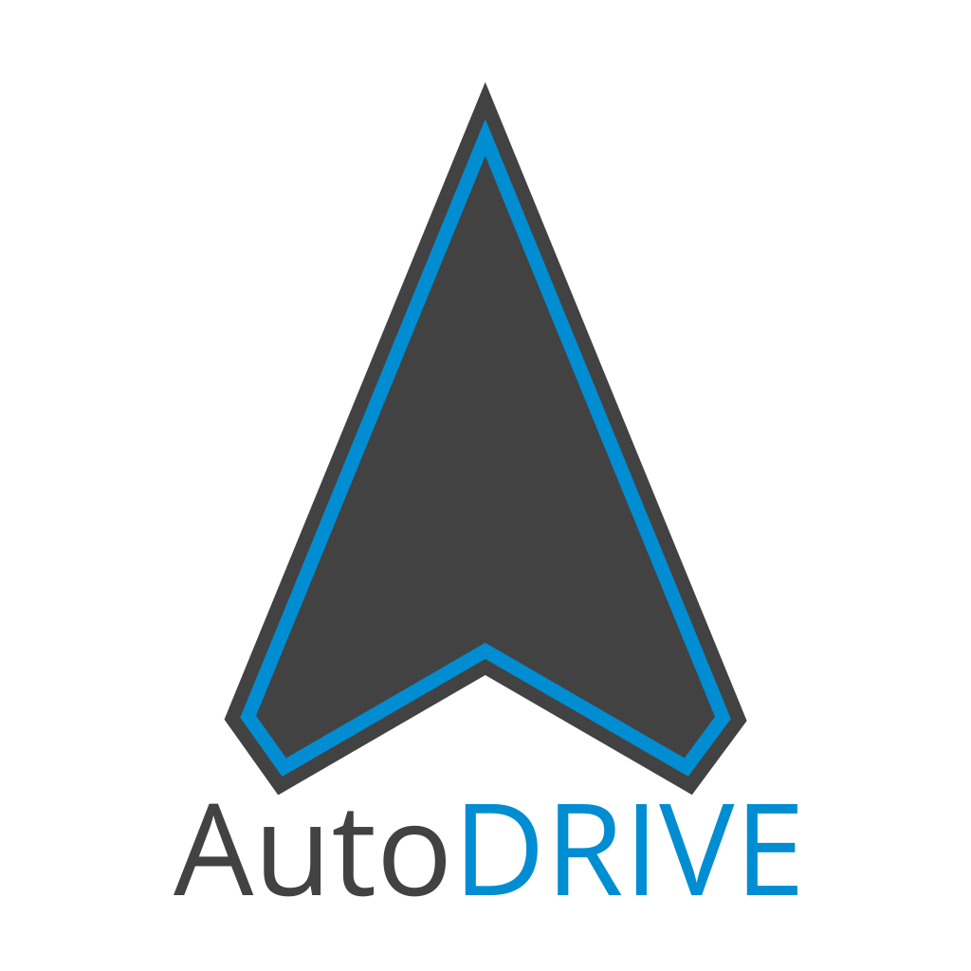

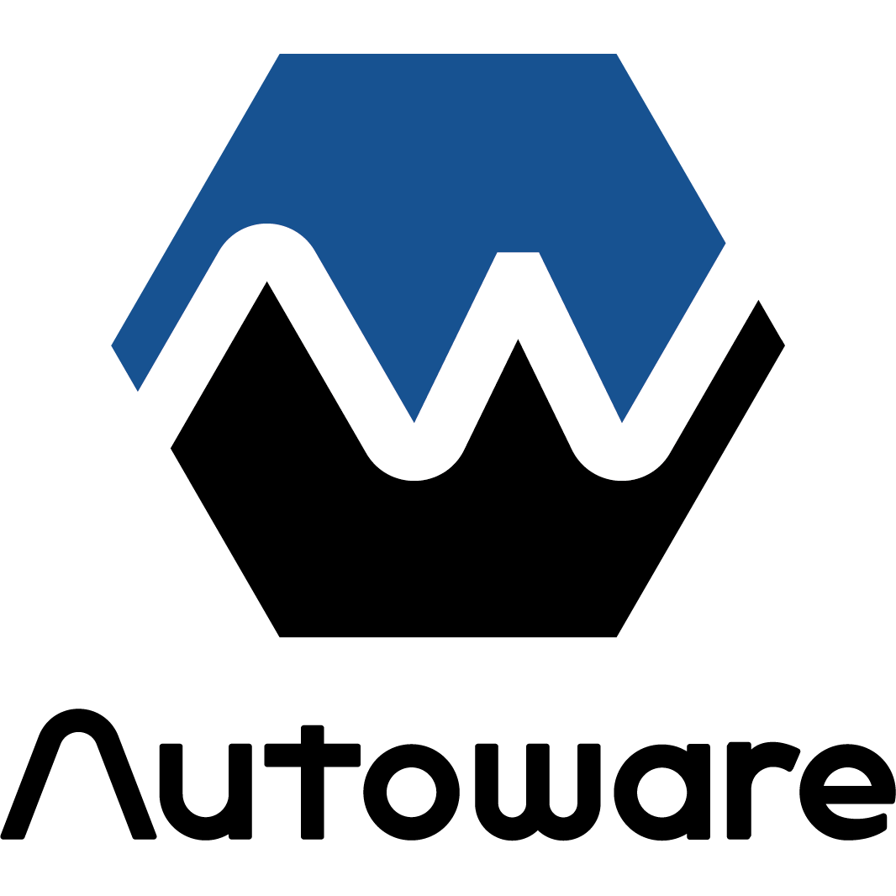
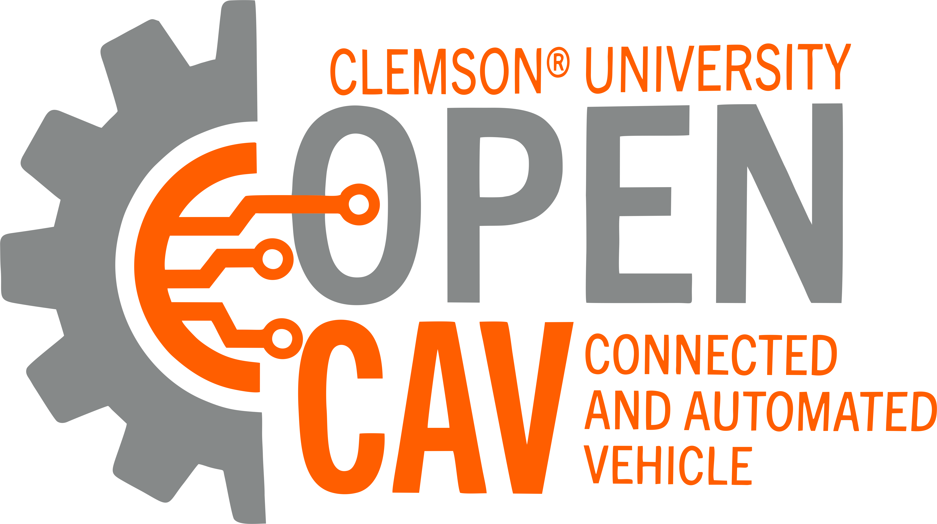
Planned Project Objectives
Theme: digital twins + vehicle scale + Autoware
ODD focus: on-road autonomous navigation
Platforms:
Small-scale: Nigel/F1TENTH
Full-scale: OpenCAV
Simulation: AutoDRIVE Simulator
Software-stack: Autoware
True digital twin framework:
Immersive teleoperation demo
Autoware demo:
Autonomous navigation (waypoint following)
Documentation

Slide 3
Planned Project Objectives
AuE-8360 Capstone Project (Fall 2023)
Task | 10/18 | 10/25 | 11/01 | 11/08 | 11/15 | 11/22 | 11/29 | 12/06
Announcements
Project Proposal
Phase 1
Phase 2
Phase 3
Project Presentation
Project Report

Slide 4
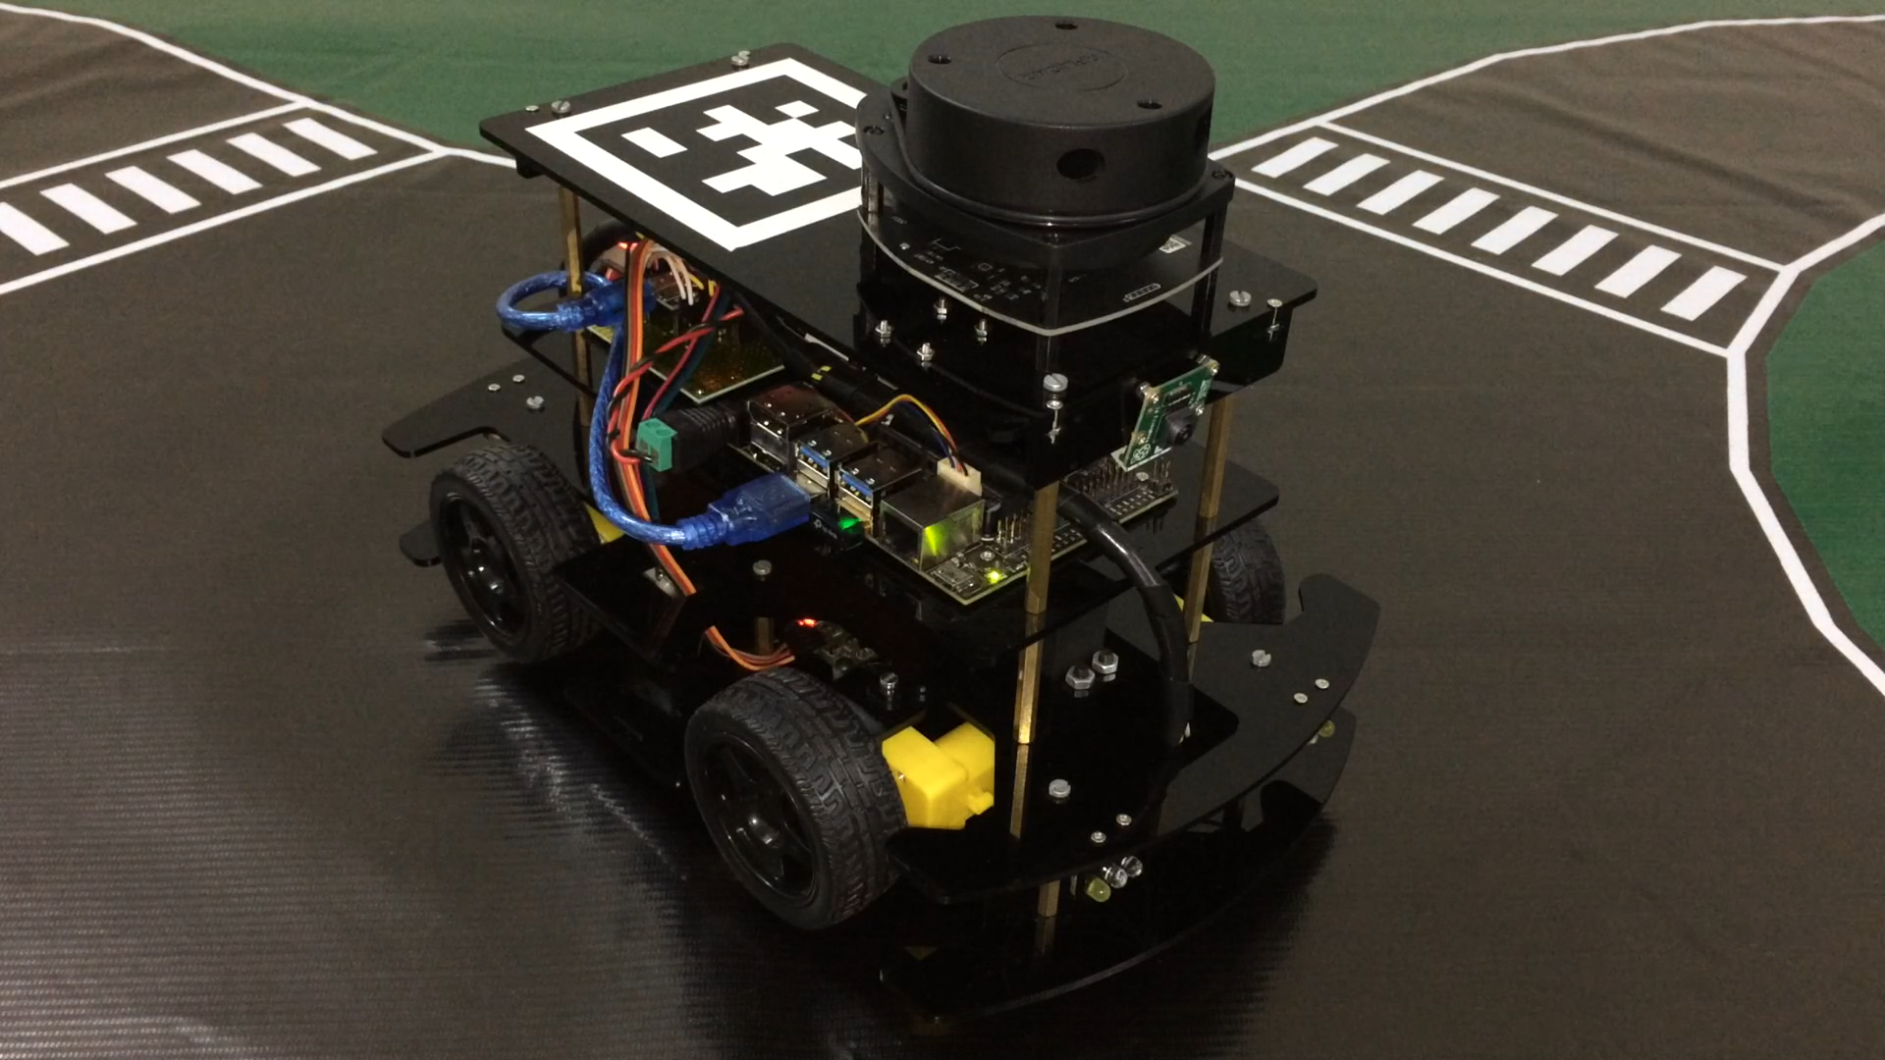
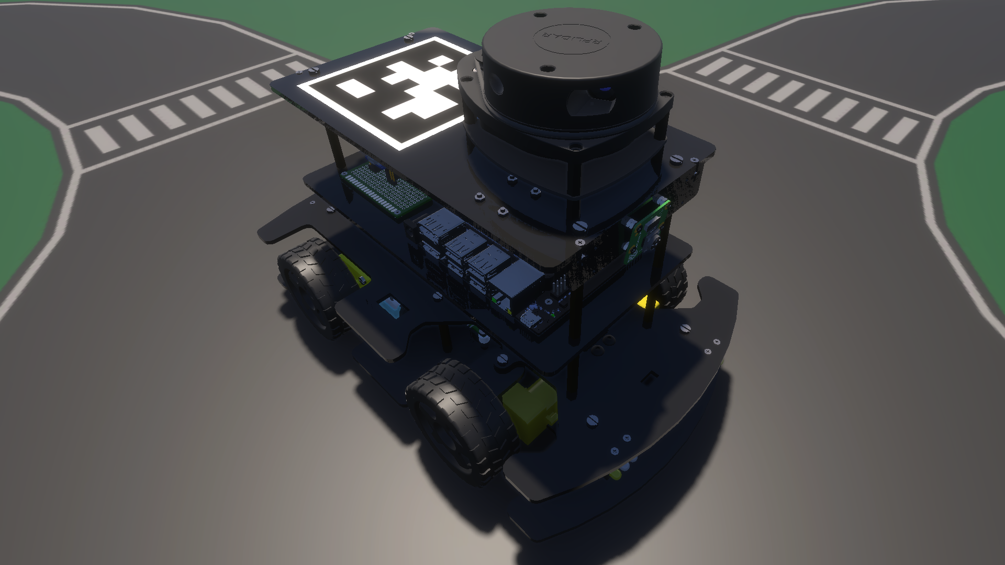
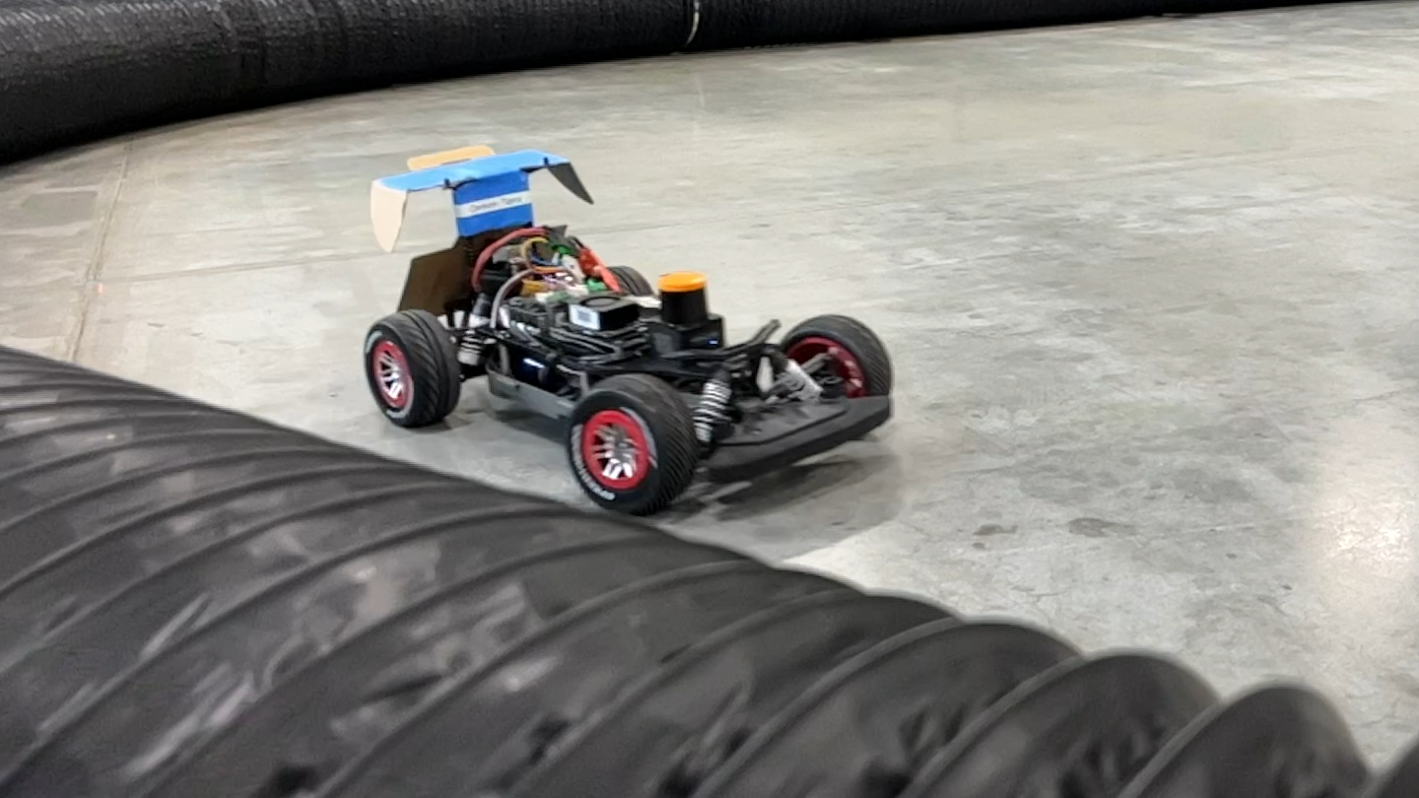
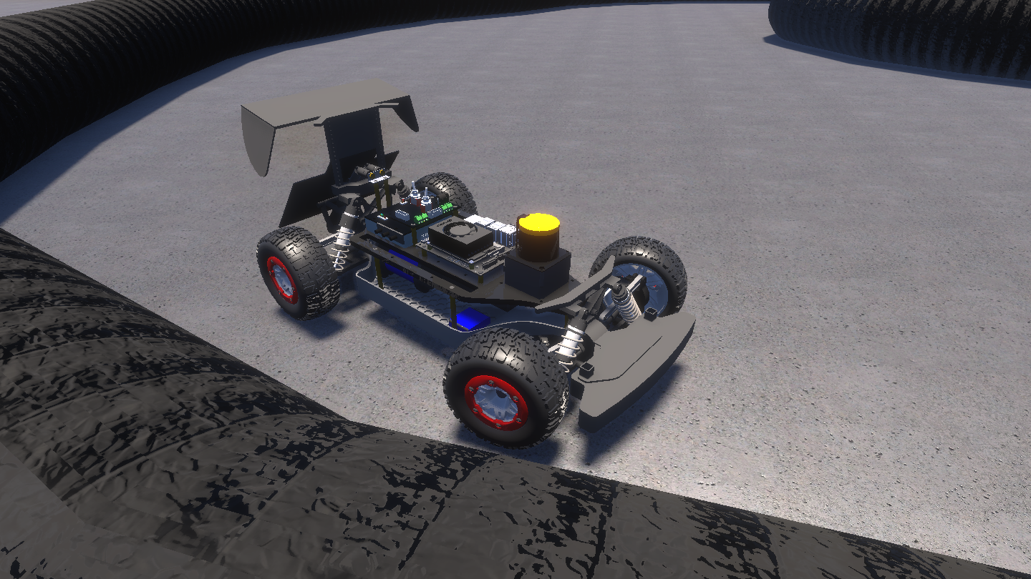
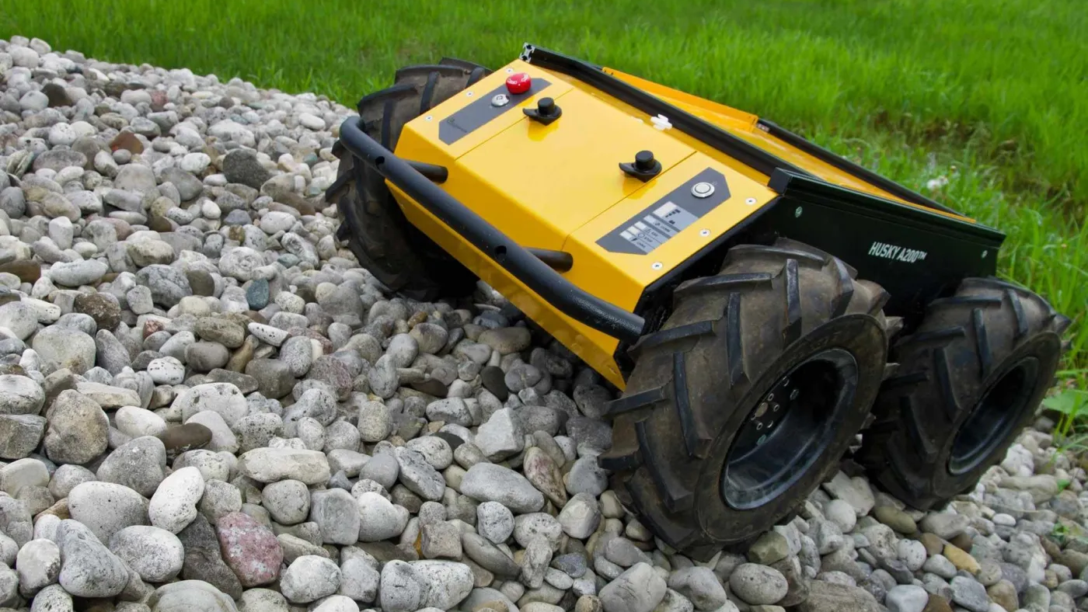
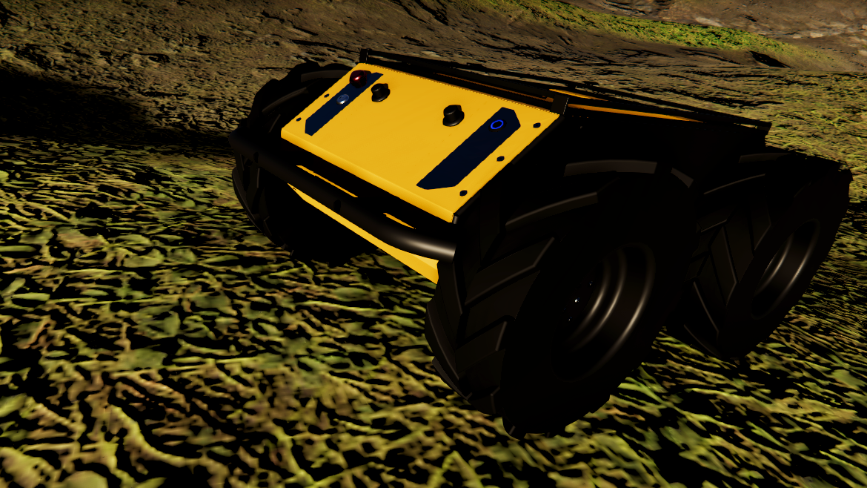
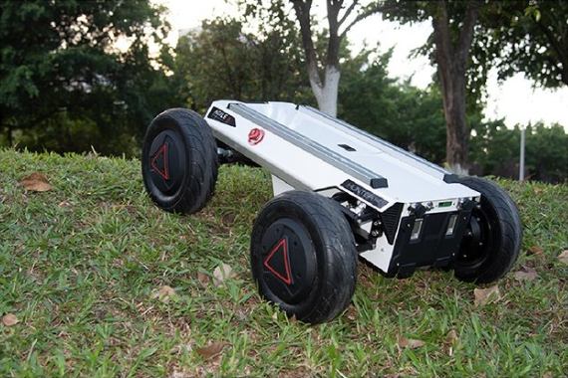
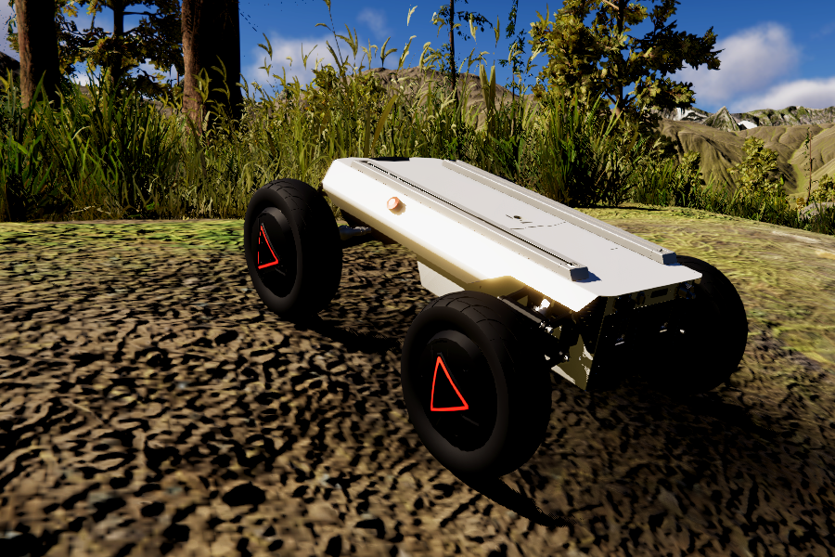
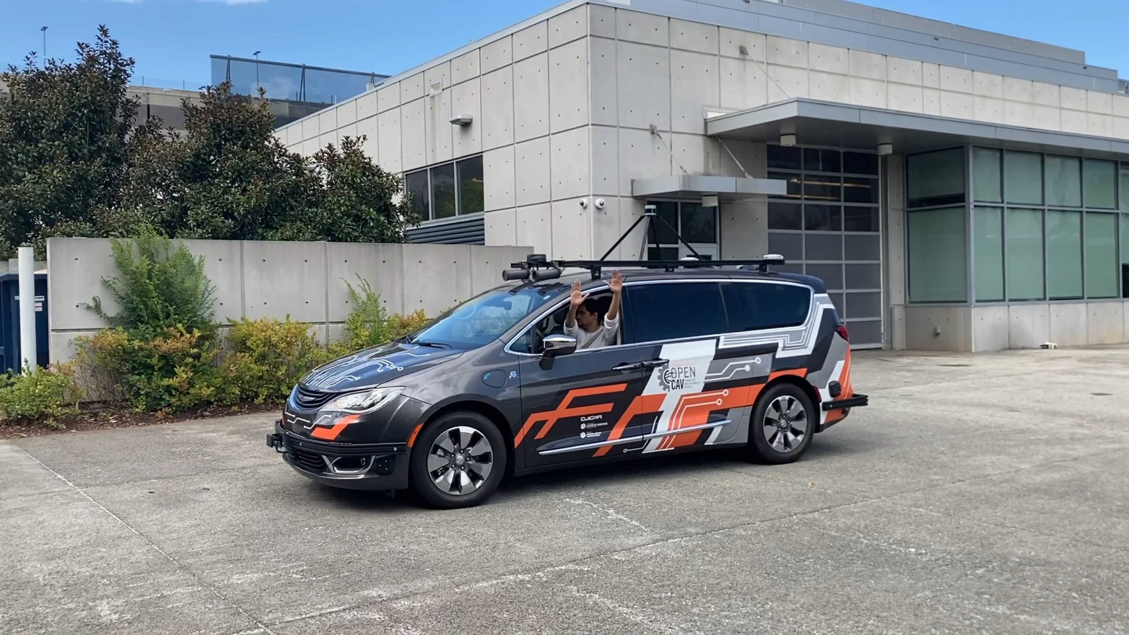
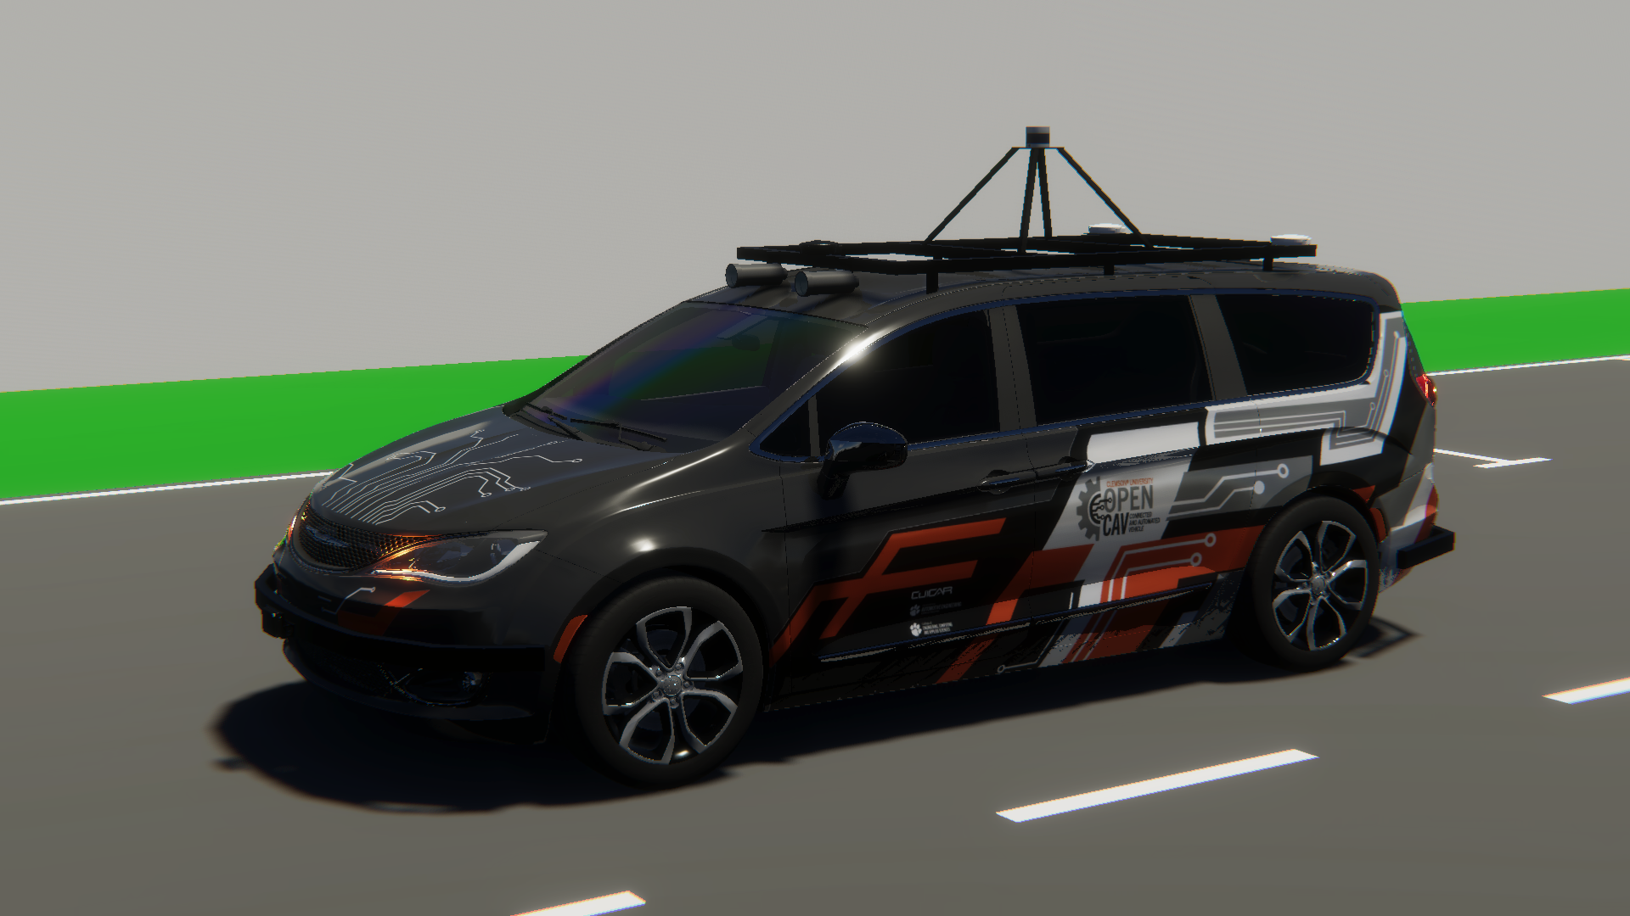
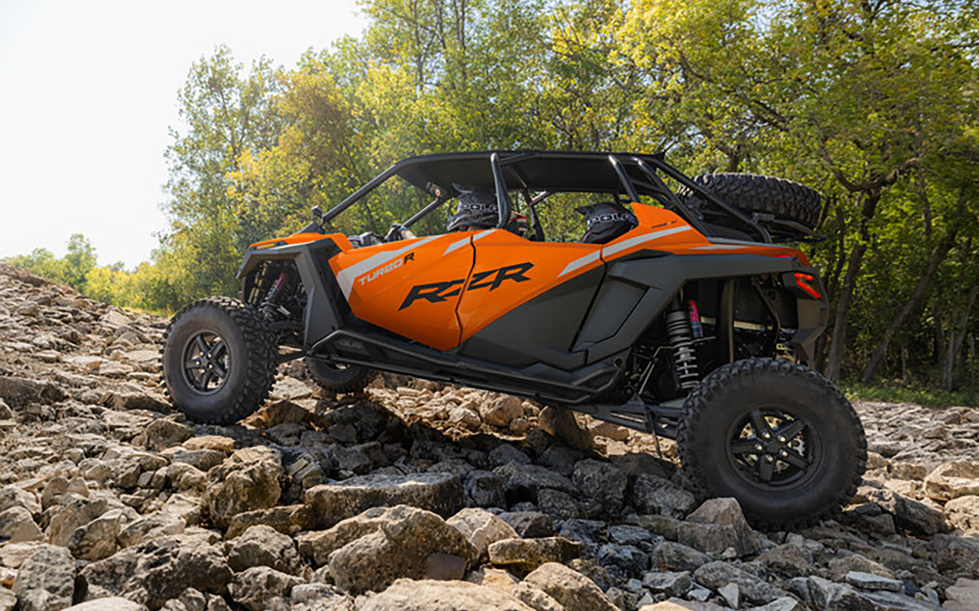
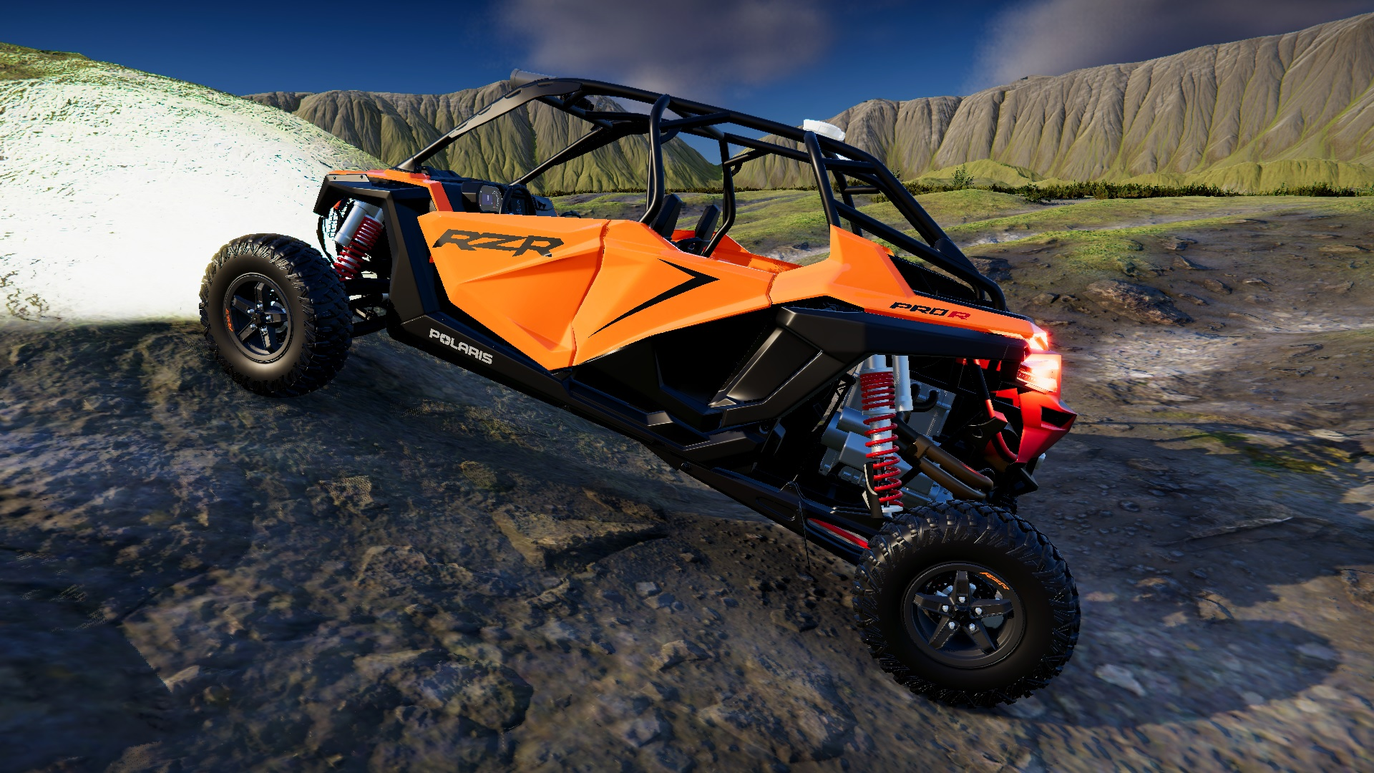
Digital Twin Models in AutoDRIVE Ecosystem
SMALL-SCALE
Nigel (Native Vehicle)
F1TENTH (1/10th Scale Racecar)
MID-SCALE
Husky (On/Off-Road Skid-Steer Robot)
Hunter SE (On/Off-Road Ackermann Steered Vehicle)
FULL-SCALE
OpenCAV (On-Road Commercial Vehicle)
RZR (Recreational Off-Highway Vehicle)
Source: AutoDRIVE Ecosystem

Slide 5
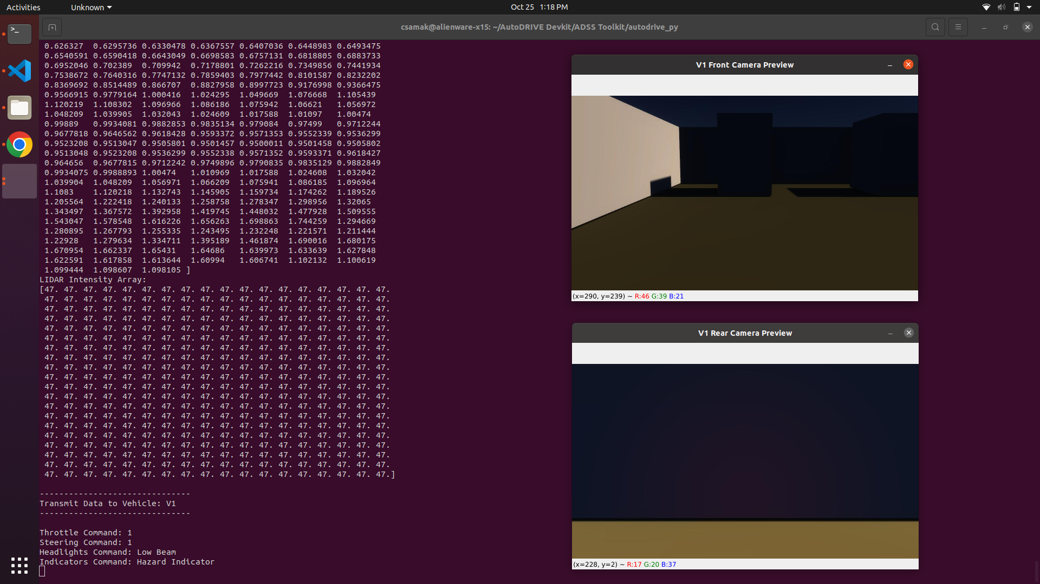
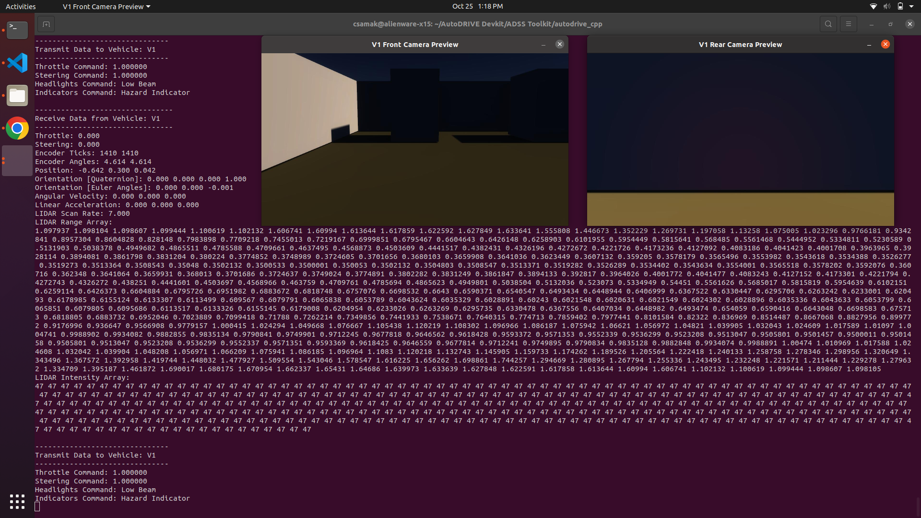
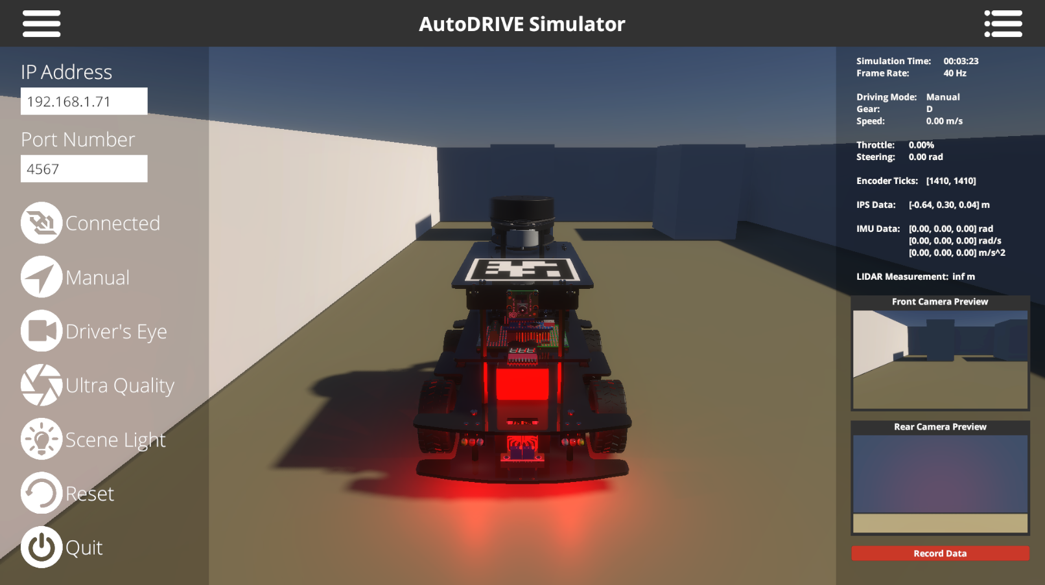

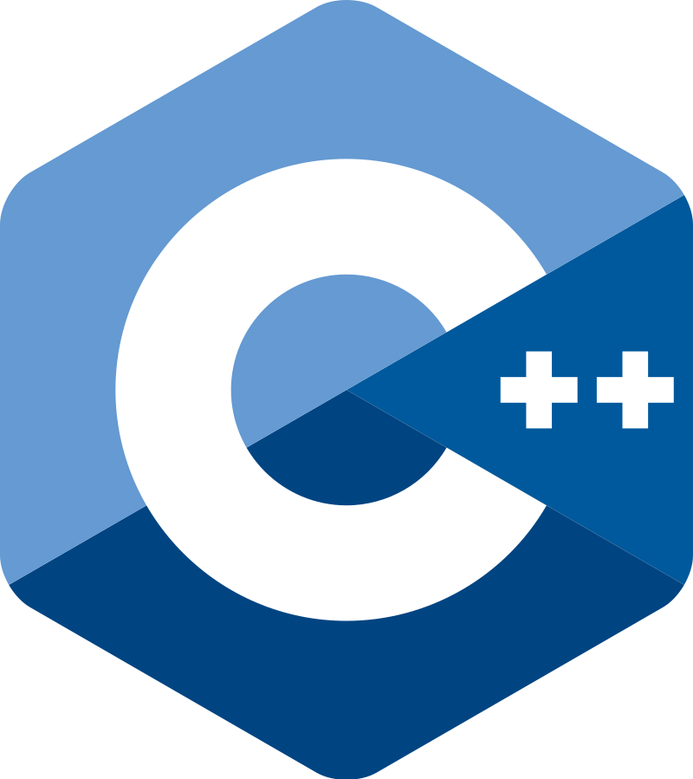
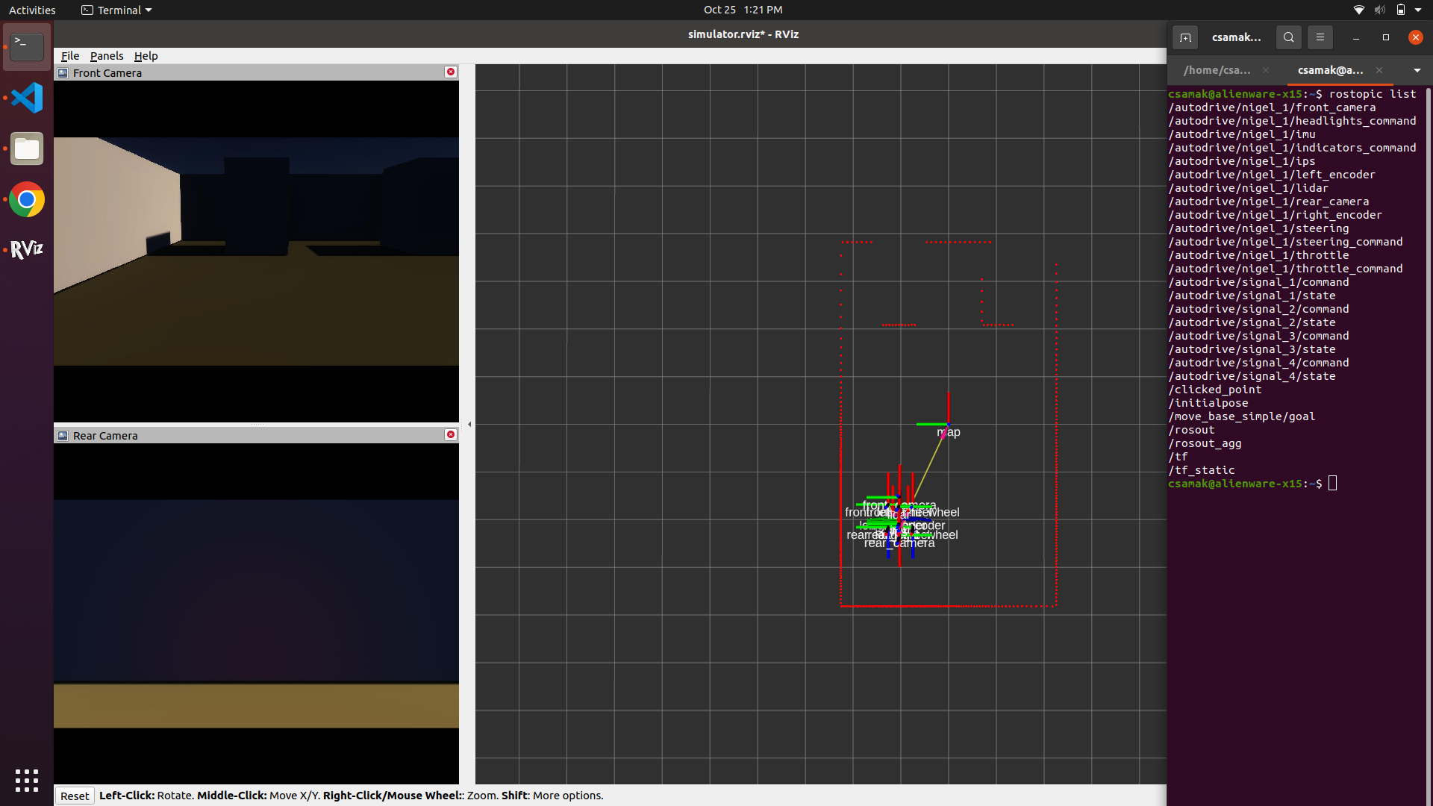
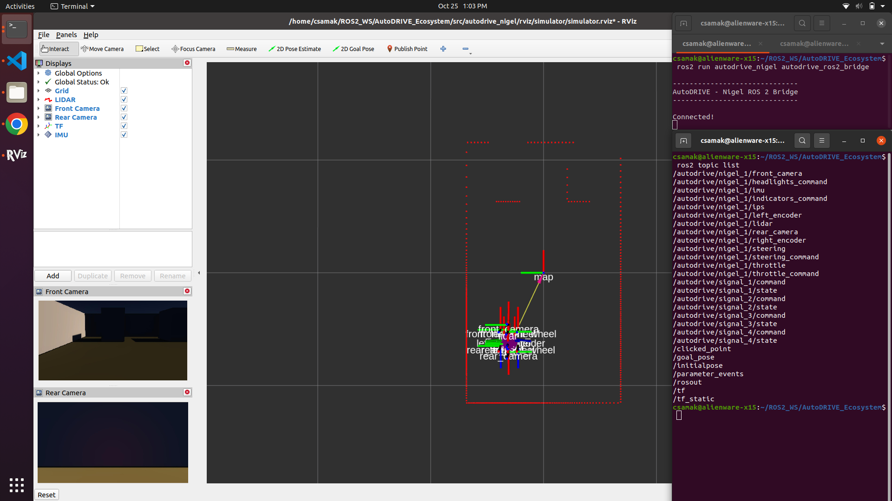


APIs to connect with AutoDRIVE Ecosystem
Python
C++
AutoDRIVE
ROS
ROS 2

Slide 6
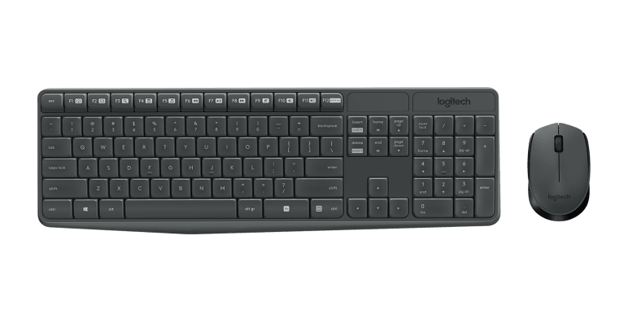
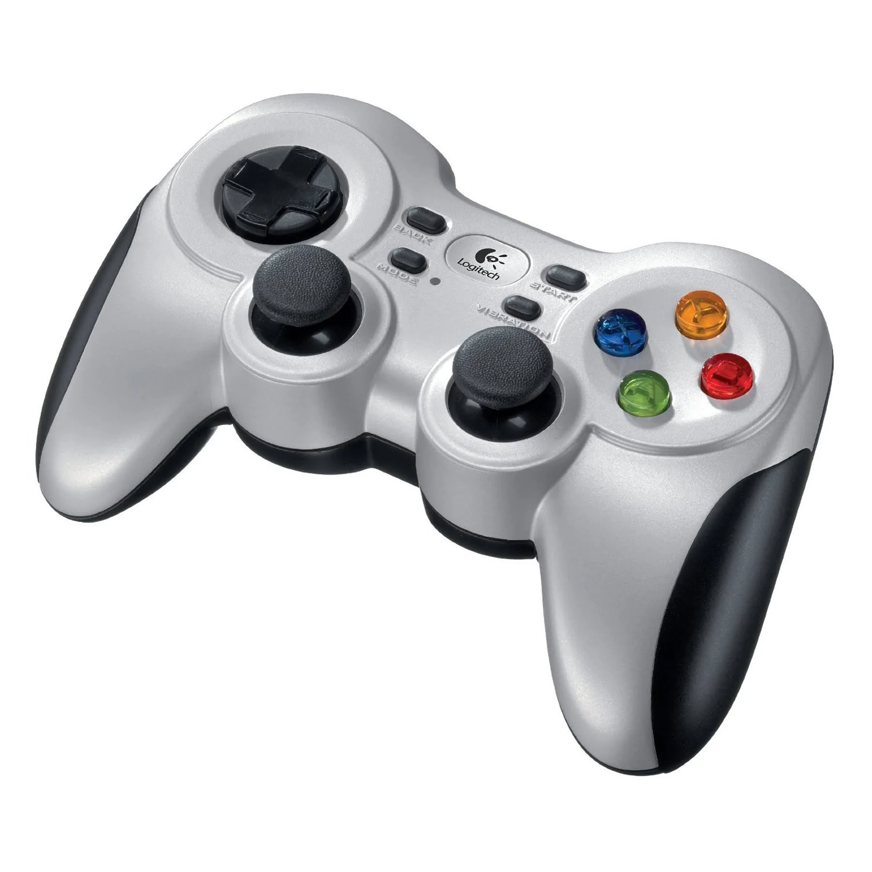
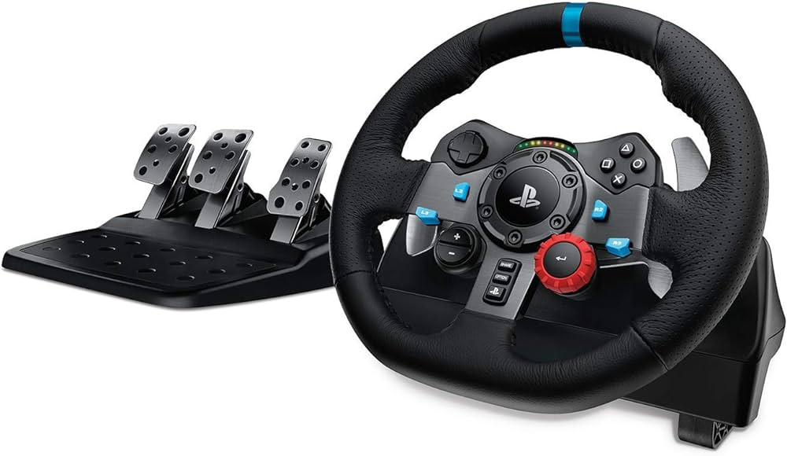

HMIs to connect with AutoDRIVE Ecosystem
AutoDRIVE
Keyboard+Mouse
Gamepad
Driving Rig
Direct HMI vs. API-Mediated HMI

Slide 7
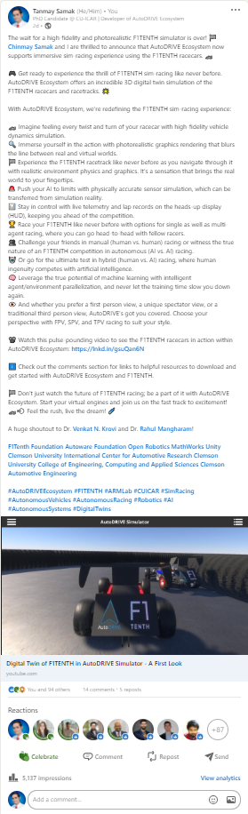
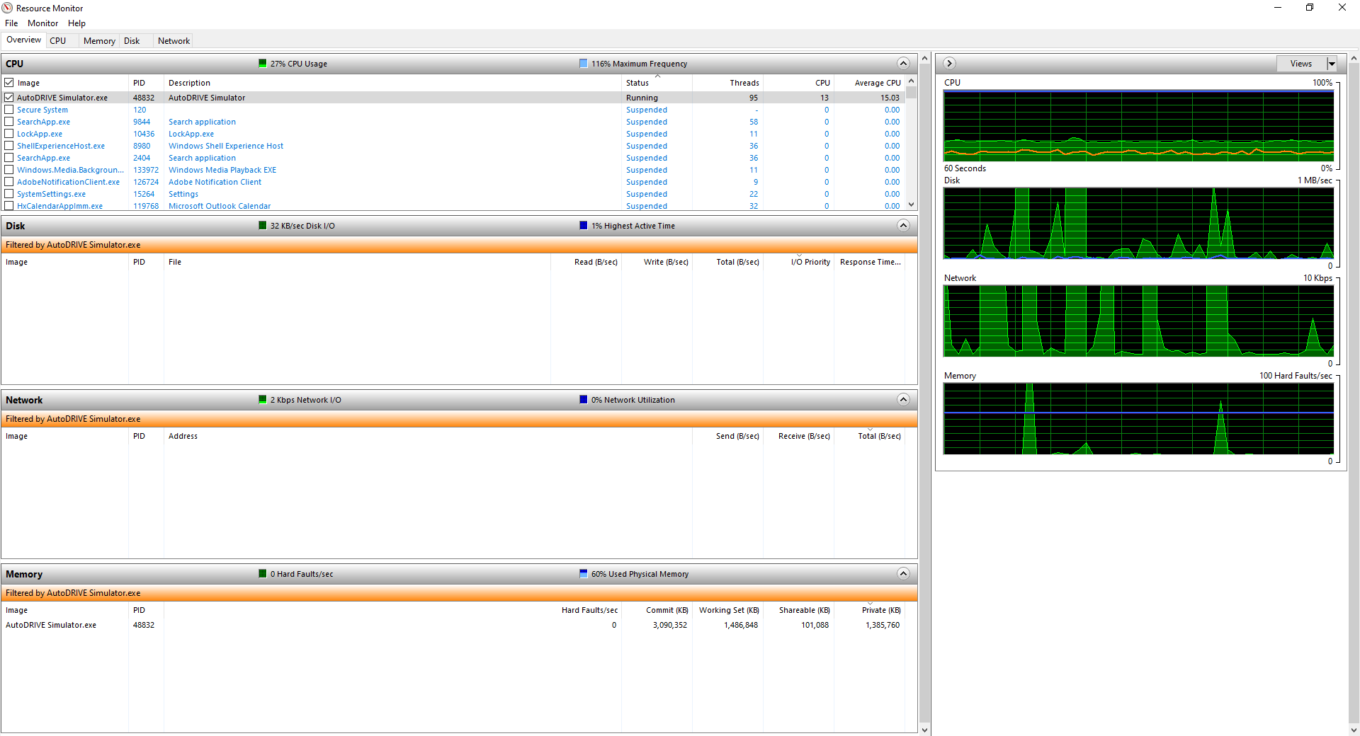
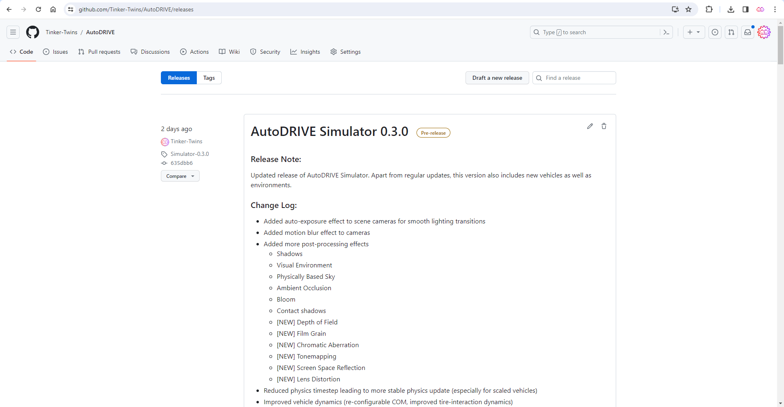
AutoDRIVE Ecosystem Updates
Computing: Multi-threading
Profiling: Alienware X15
Platforms: Husky, Hunter SE
Sensors:
Modularize 2D and 3D LIDARs
API for 3D LIDAR [in progress]
Nigel assembly guide and BOM
Release:
AutoDRIVE Simulator 0.3.0
AutoDRIVE Devkit 0.3.0
LinkedIn Post

Slide 8
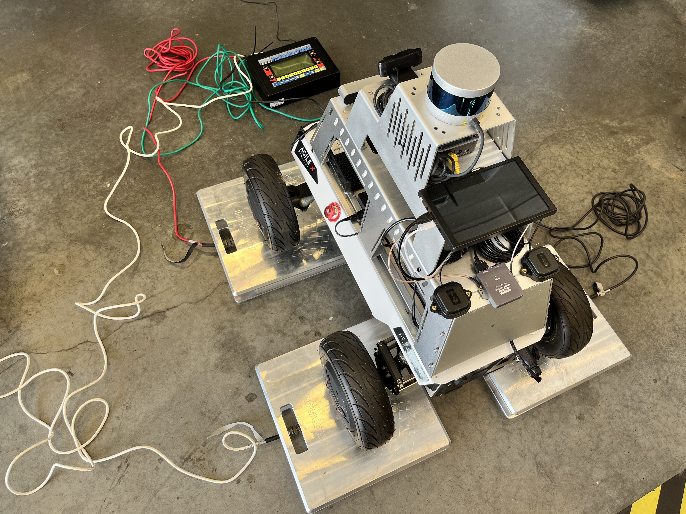
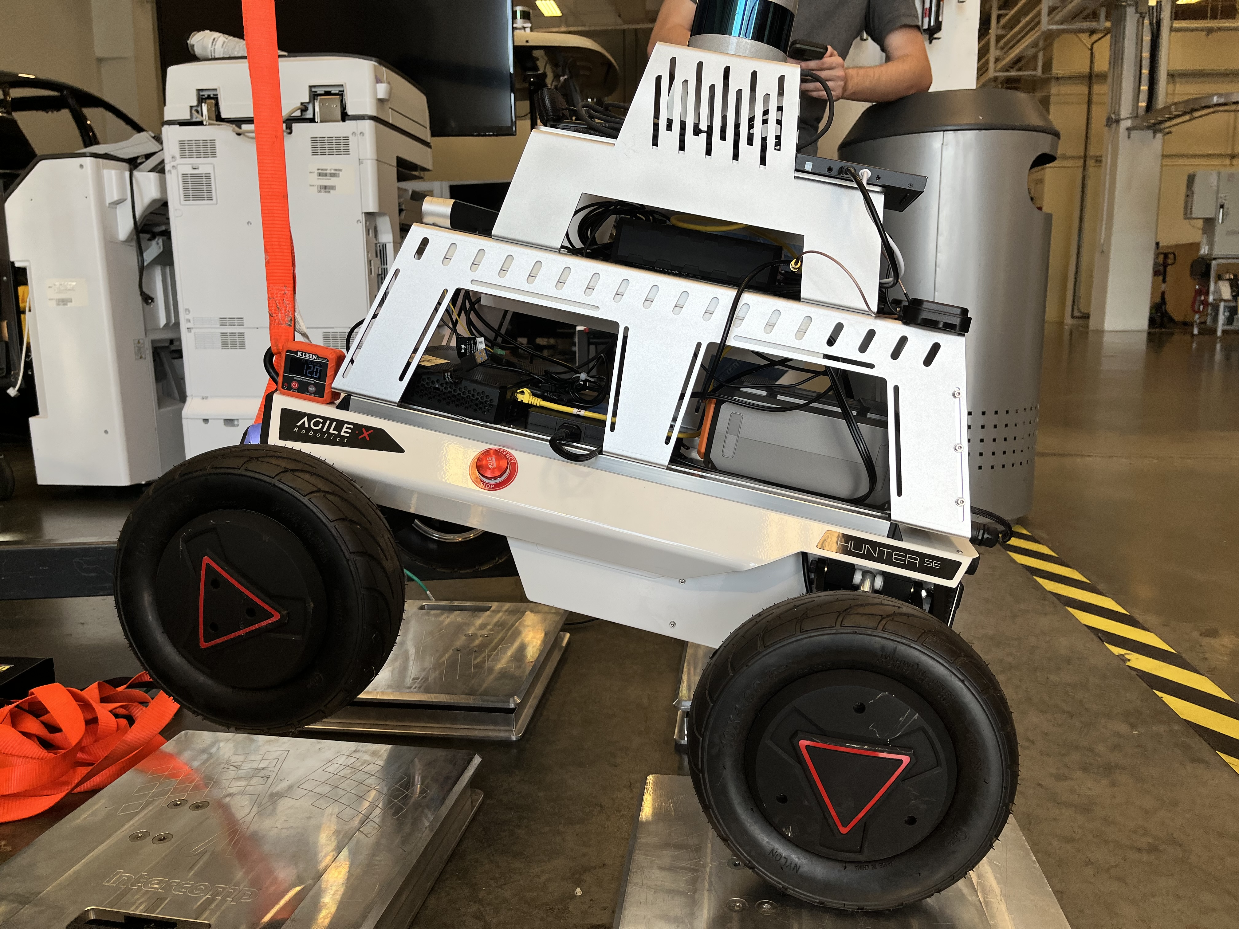
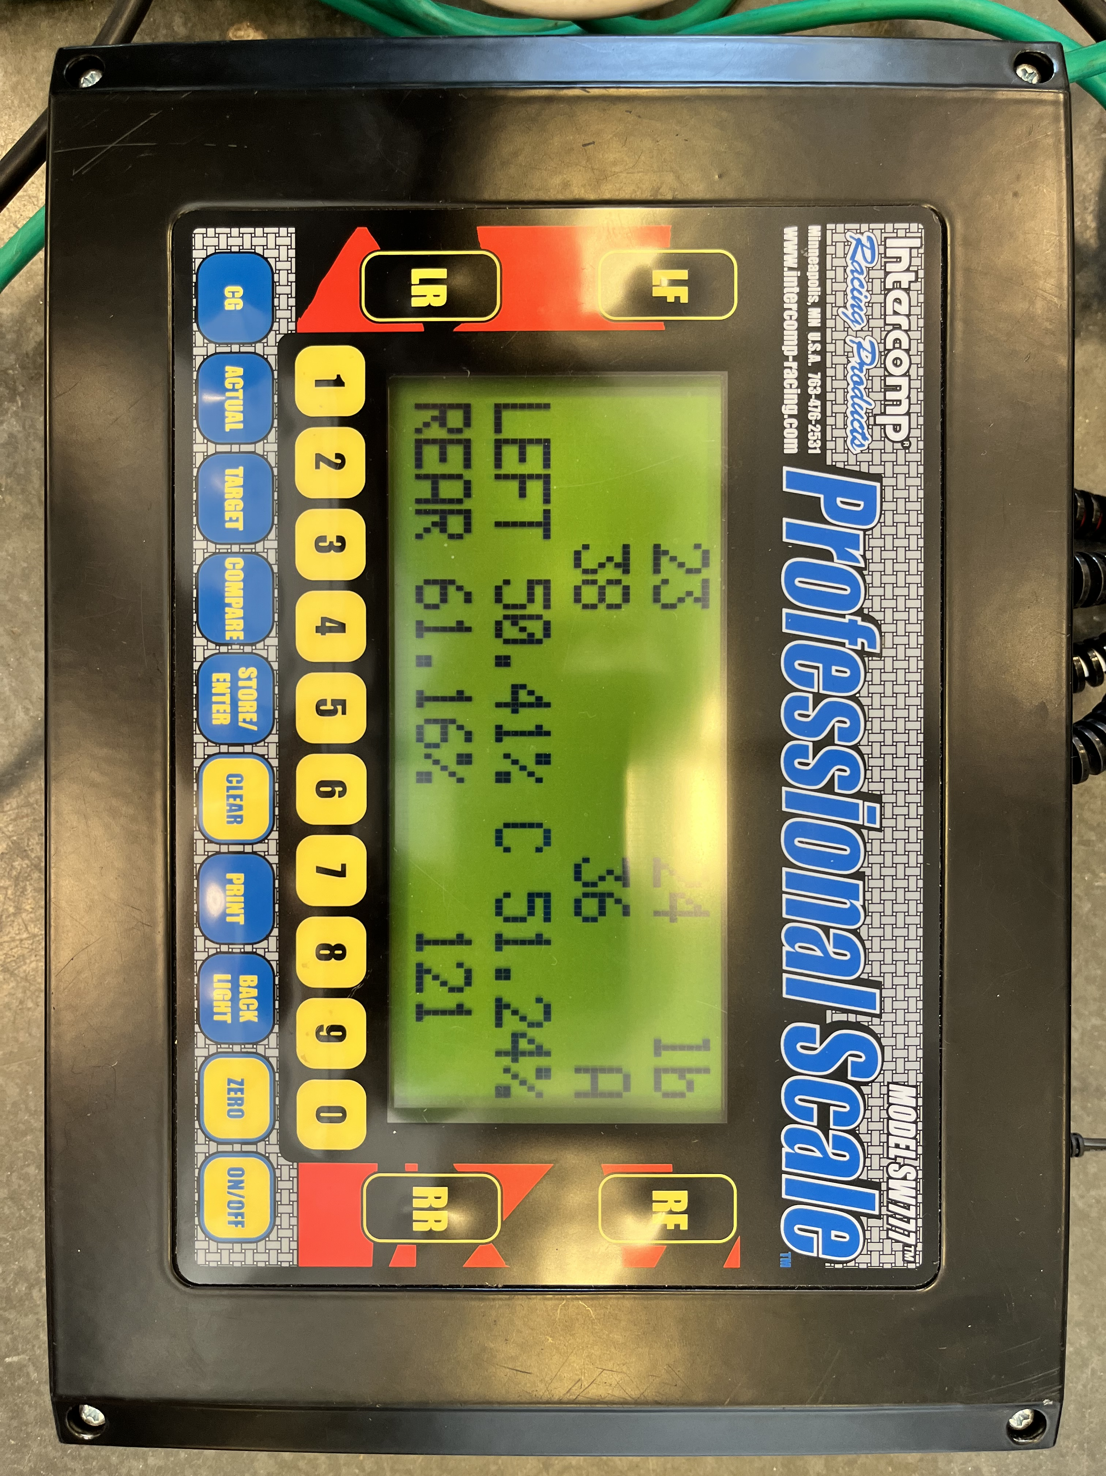
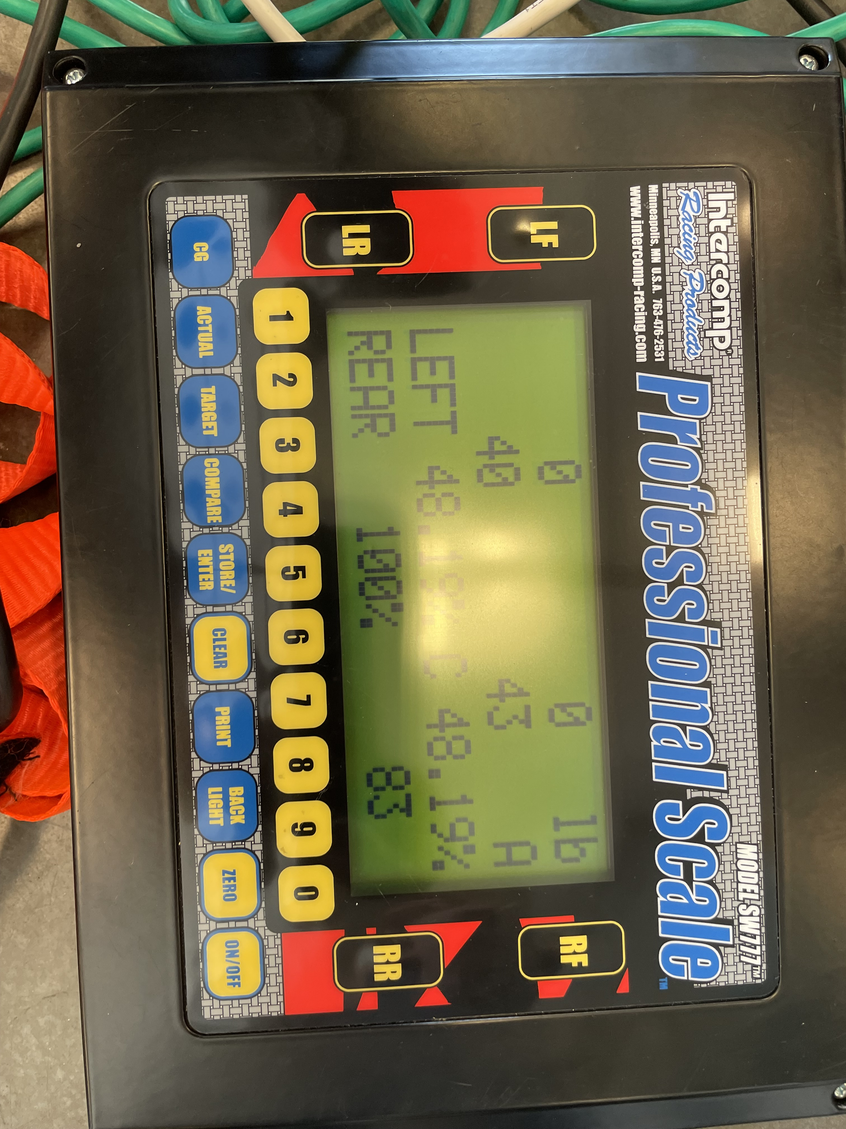
Mid-Scale Robot Updates
Hunter SE System ID
Geometric Measurements
Static measurements
Mass identification
CoM identification
Actuator limits ID [TODO]
Husky System ID
Geometric Measurements
Static measurements
TODO
Actuator limits ID [in progress]

Slide 9
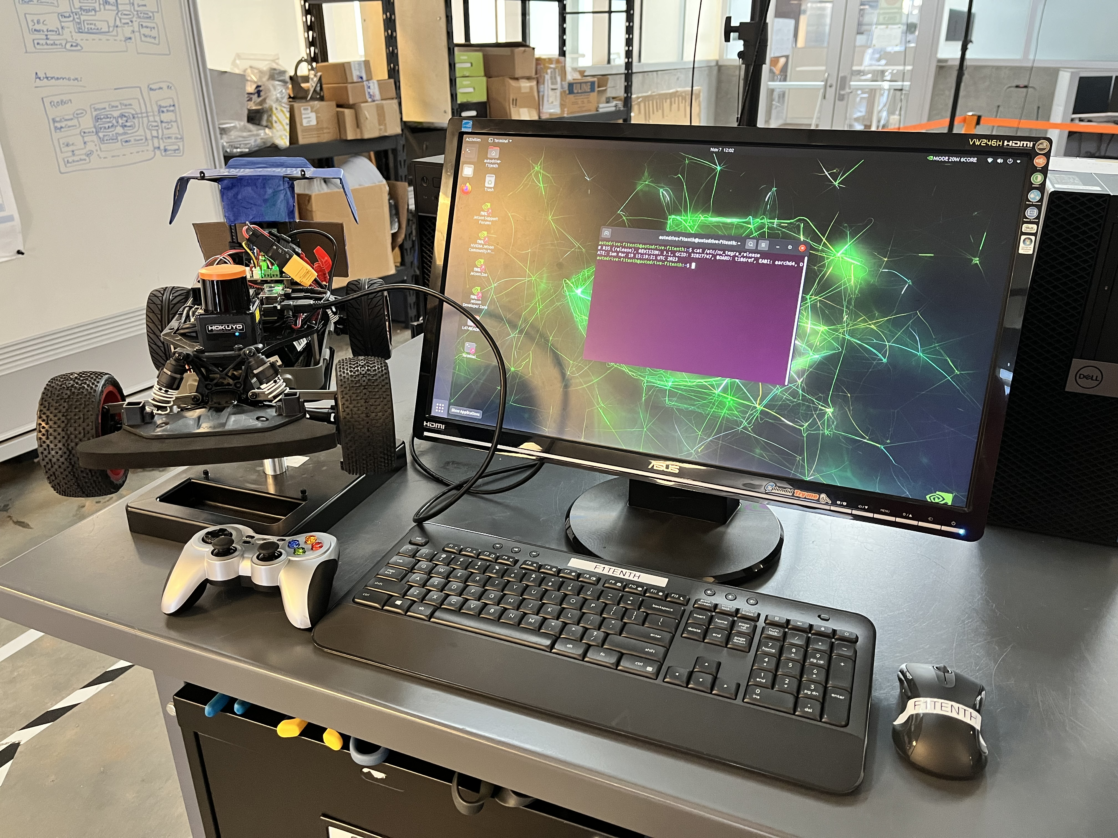
F1TENTH Vehicle Updates
Reflash SD Card with L4T Ubuntu 20.04
JetPack 5.1.1
Flashing instructions [1] [2]
Install ROS 2 Galactic
Install instructions
Install Autoware Universe [in progress]

Slide 10
References
T. Samak, C. Samak, S. Kandhasamy, V. Krovi, and M. Xie, “AutoDRIVE: A Comprehensive, Flexible and Integrated Digital Twin Ecosystem for Autonomous Driving Research & Education,” Robotics, vol. 12, no. 3, p. 77, May 2023, doi: 10.3390/robotics12030077
W. Ding, C. Xu, M. Arief, H. Lin, B. Li and D. Zhao, “A Survey on Safety-Critical Driving Scenario Generation—A Methodological Perspective,” in IEEE Transactions on Intelligent Transportation Systems, vol. 24, no. 7, pp. 6971-6988, July 2023, doi: 10.1109/TITS.2023.3259322
M. Quigley, K. Conley, B. Gerkey, J. Faust, T. Foote, J. Leibs, R. Wheeler, and A. Ng, “ROS: an open-source Robot Operating System,” in ICRA 2009 Workshop on Open Source Software, vol. 3, Jan 2009. [Online]. Available: http://robotics.stanford.edu/~ang/papers/icraoss09-ROS.pdf
S. Macenski, T. Foote, B. Gerkey, C. Lalancette, and W. Woodall, “Robot operating system 2: Design, architecture, and uses in the wild,” Science Robotics, vol. 7, no. 66, p. eabm6074, 2022. [Online]. Available: https://www.science.org/doi/abs/10.1126/scirobotics.abm6074
Autoware Foundation, “Autoware Project: The world’s leading open-source software project for autonomous driving.” [Online]. Available: https://autoware.org

